Slide 1
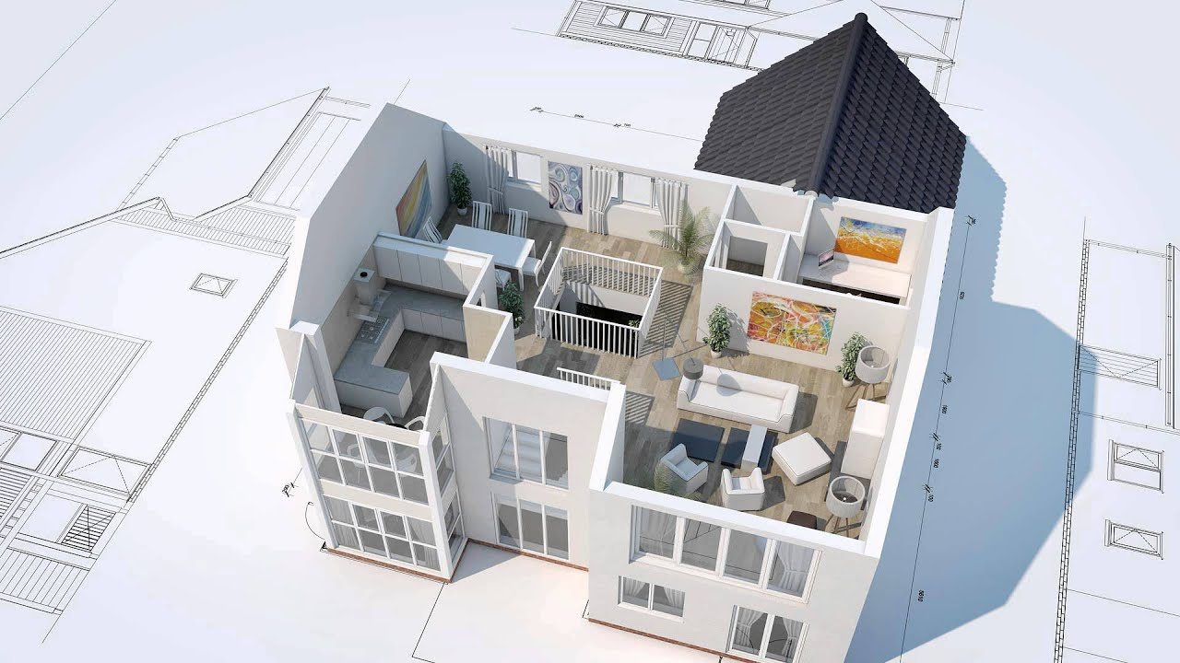
AUTOGENERATION OF 3D MODELS FROM 2D FLOOR PLAN IMAGES
2016-CE-54
2016-CE-72
2016-CE-81
2016-CS-159

Slide 2
Idea Defence Presentation
Supervisor
Dr. Sheikh Faisal Rasheed
Co-Advisor
Mr. Ahmad Awais
Computer Science and Engineering Department, UET Lahore.

Slide 3
Agenda
Introduction
Problem Statement
Motivation
Objectives
Scope
Target Audience
Existing System
Proposed System
Methodology
Idea Complexity
Possible Applications of Work
Feasibility Study
Market Survey
Limitations and Challenges

Slide 4
1. INTRODUCTION
Overview
Automatically generate 3D model according to the image of imported 2D floor plan.
Enables users to do interior designing in 3D generated model.
The techniques of image processing and model mapping used to generate the 3D computer graphics model
Have different viewpoints i.e. top-view, walk-through, front-view and side-view of 3D generated model.

Slide 5
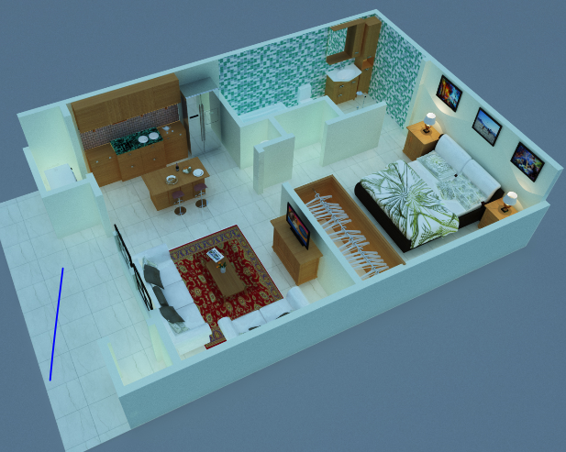
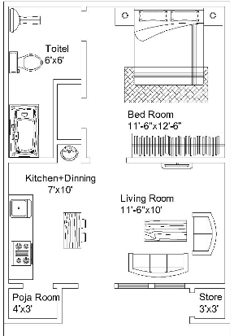

1. INTRODUCTION(Contd.)

Slide 6
1. INTRODUCTION(Contd.)
Background
Why we need to initiate it?
What problems and needs it will address?

Slide 7

2. PROBLEM STATEMENT
When anyone plans to construct a new ﬂat/house and can only see its ﬂoor plan. So it’s hard for anyone to imagine the actual environment by just seeing 2-D ﬂoor plan. Sometimes users also get curious how to design the interior of house. So, this system will enable users to generate and edit 3D model eﬃciently in less time and eﬀort which existing systems unable to do.

Slide 8
3. MOTIVATION
Platform for architects to see 3D models of their 2D floor plans before actual implementation and enables them to do interior designing
Get rid to do a lot of manual work to generate 3D models unlike existing systems
Computer Vision , Artificial Intelligence And Software Engineering subject areas motivated us to do this project

Slide 9
4. OBJECTIVES
Research Objectives
To ﬁnd out the planners/customers relationship on the behavior of house construction
To identify and provide solutions of the problems faced by users while constructing houses
To predict the behavior of people who are using such 3D modeling softwares

Slide 10
4. OBJECTIVES(Contd.)
Industry Objectives
Implement a system that fulfils the demands of industry in less time and cost.
To increase industry sales and proﬁt by automatically generating 3D models which seeks customers attraction and grow market shares
Academic Objectives
To ensure, this project is being done by using latest technologies which helps students and technical persons to enhance their academic skills via learning and integrating new textures about 3D modelling.

Slide 11

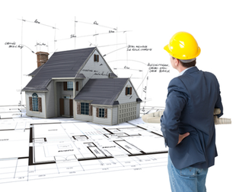


5.SCOPE OF THE PROJECT
Facilitate architects, home-planners
Interior Designers
Common Users
Image Processing
Computer Graphic Techniques

Slide 12
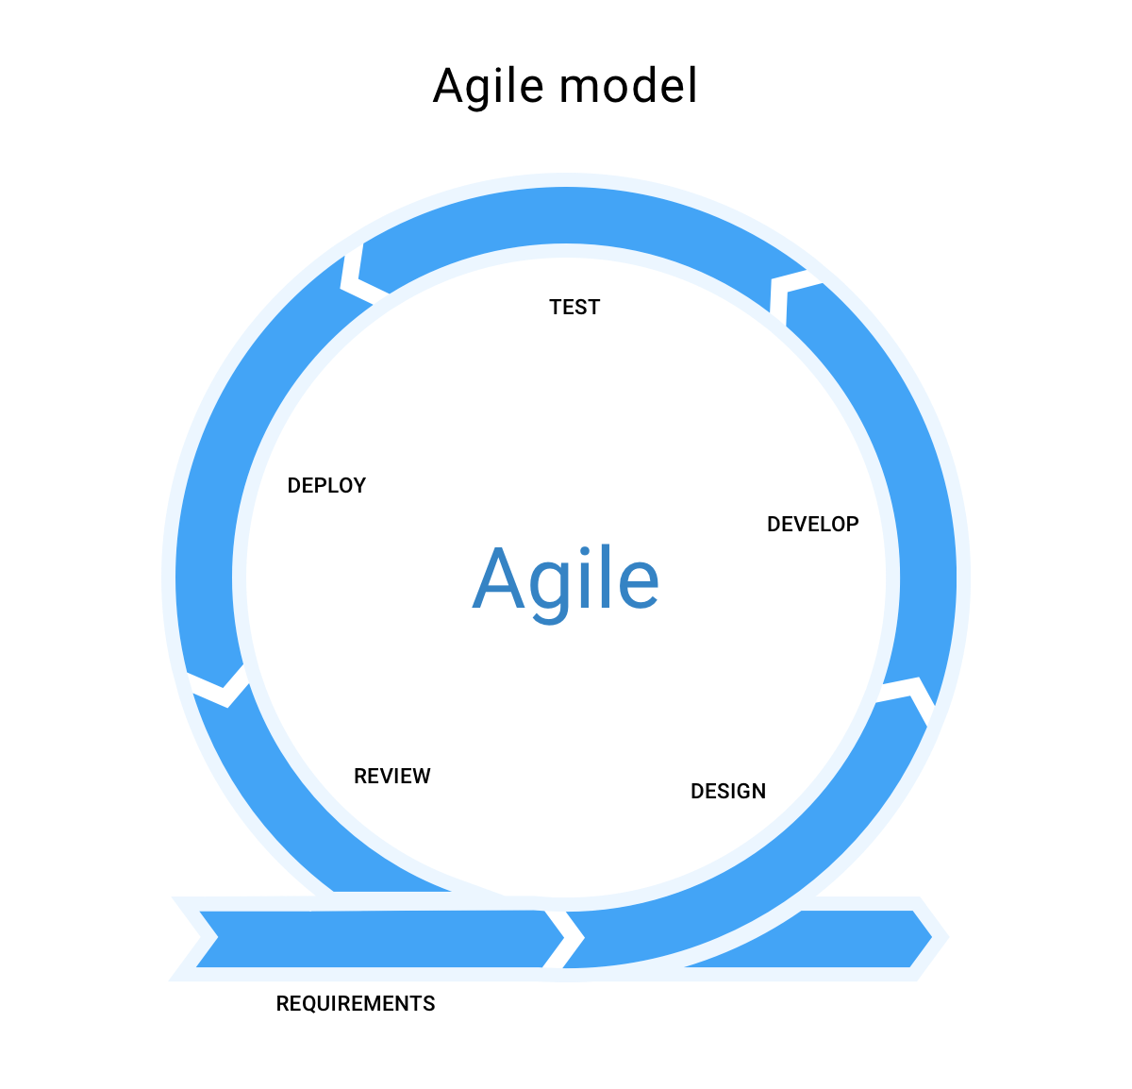
6. METHODOLOGY
For the satisfactory result of the software , we will use agile method to validate and verify it. Agile method will help us to test and then add more functions if necessary.

Slide 13
7. TARGET AUDIENCE
Common Users
Interior Designers
Architects and Home planners
Real estate sellers agents

Slide 14
8. EXISTING SYSTEM
Sketch Up
SweetHome3D
Blender
Free CAD Software
Solid Works

Slide 15
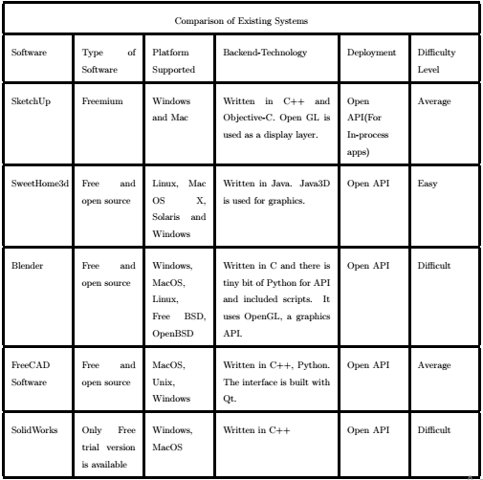
9. EXISTING SYSTEM

Slide 16
10. DRAWBACKS OF EXISTING SYSTEM
Different objective
Manual work
Customized GUI
Time taking
Cost issue
Technical skills required
Input issue

Slide 17
11. PROPOSED SYSTEM
Project Idea
Develop a unity based desktop application
Use python scripts for image processing
Innovation factor
Features
Import 2d floor plan
Generate 3d model
Modify 3d model

Slide 18
12. PROJECT ARCHITECTURE
Read image of 2D floor plan
Object Detector
Scaling and setting of parameters for 3D model
Wall construction and Object mapping
Floor construction.
3D model editor
View of 3D generated model
2D floor plan in image format
External 3D model and texture file

Slide 19
13. IDEA COMPLEXITY
h
Smart
Complex
How our idea is

Slide 20
14. POSSIBLE APPLICATIONS OF WORK
Platform for interior designing of 3D generated model
Platform for architects to generate 3D model efficiently with less time and effort.
Platform for home planners, real estate selling agents to win customer satisfaction and for efficient sales promotions.

Slide 21
15. FEASIBILITY STUDY
Technical Feasibility
Operational Feasibility
Economical Feasibility

Slide 22
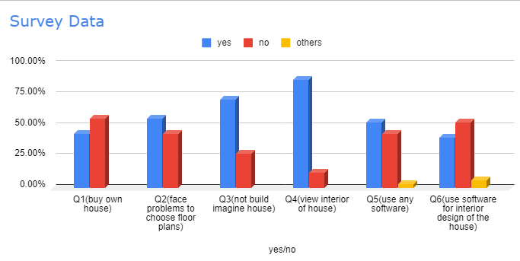
16. FEASIBILITY STUDY(Contd.)

Slide 23
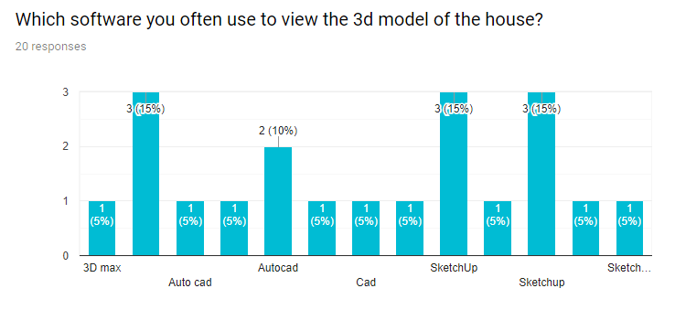
17. FEASIBILITY STUDY(Contd.)

Slide 24
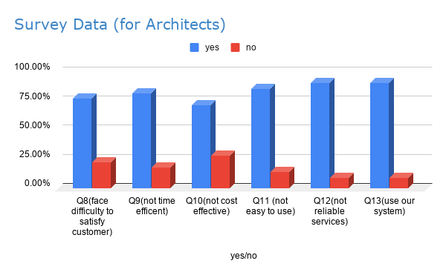
18. FEASIBILITY STUDY(Contd.)

Slide 25
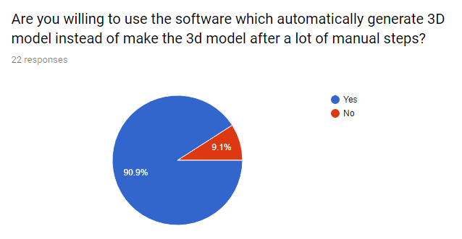
19. MARKET SURVEY

Slide 26
20. LIMITATIONS AND CHALLENGES
Selection of Software and 3D graphic tools
Compatibility of programming language with graphic tools
Image Processing and recognition
Time Duration to complete the project
No background of computer graphics
Placing furniture on 3D model according to position and size

Slide 27
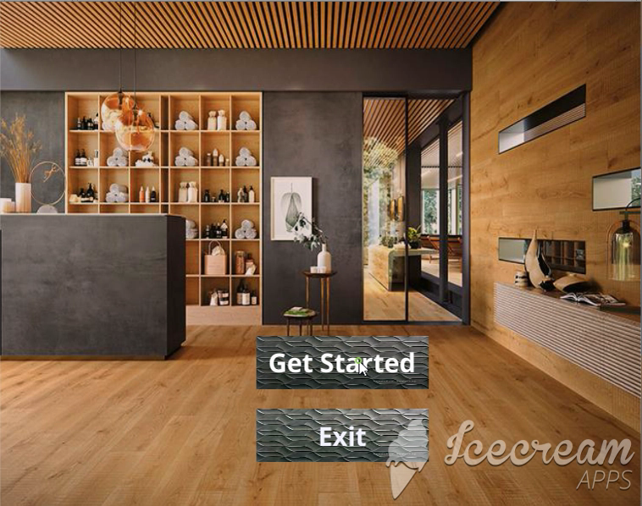

Slide 28


